Slide 1
Civil Society in Germany A quick Overview
Dr. Frank Heuberger, Representative for European Affairs, BBE
24 January 2019

Slide 2
Civil Society in Germany
THE SECTOR
The following terms are being used at present: Ehrenamt (‘honorary office / work’) or ehrenamtliche Tätigkeit (‘honorary office activity’). These terms stem from the 19th century and refer to voluntary engagement in formal organisations, e.g. associations, societies or clubs. The voluntary work is either unpaid or an expense allowance is received. Literally translated the terms refer to a ‘task or an office assumed on honorary basis‘, however, experts have considered this definition as too restrictive.
Freiwilligenarbeit (‘voluntary involvement’) or freiwilliges Engagement (‘volunteering’).
Today, these activities may be performed as part of formal or informal organisations and include sports and recreation, culture, self-help or neighbourhood activities and activities in civic action groups.

Slide 3
Civil Society in Germany
THE SECTOR
In order to reflect this wide range of activities, the concept ‘voluntary involvement‘ was introduced. Bürgerschaftliches Engagement (‘voluntary civic activities’). In the final report of the Federal Parliament’s Study Commission on the Future of Civic Activities, the term ‘voluntary civic activities‘ was used to emphasize the specific character of all activities assumed voluntarily.
Freiwilligendienste (volunteering services). In Germany, volunteering services often refer to volunteering that young people carry out for a year as part of an official programme after they have finalized their upper secondary education, and before they start university studies (for example ‘Voluntary Year of Social Services‘ or ‘Voluntary Year of Ecological Services‘). Other types of volunteering services do, however, also exist, such as voluntary services abroad.

Slide 4
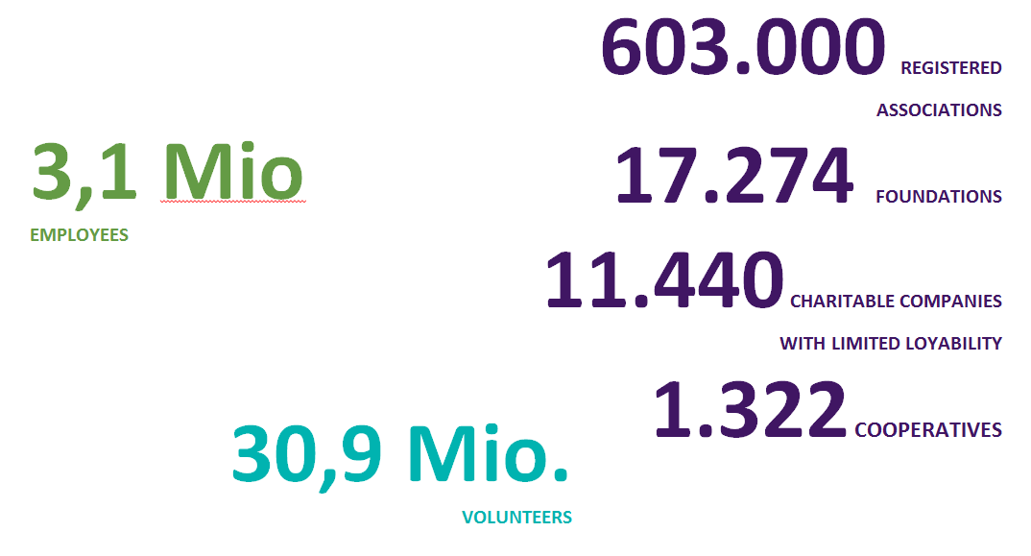
Civil Society in Germany
THE SECTOR

Slide 5
Civil Society in Germany
NON-PROFIT STATUS
In Germany, there are a limited number of legal forms that are suitable for nonprofit activities.
These are:
registered association (eingetragener Verein),
Local level third sector activities are associated with the term Verein (voluntary organization) and put into practice by Vereine, whereas third sector organizations operating at the federal and sub-national level are characterized as Verband and thus as umbrella associations. The reason there is a distinction between local third sector activities and those that take place beyond the local level is closely linked to the very notion of the decentralized Federal Republic of Germany.

Slide 6
Civil Society in Germany
NON-PROFIT STATUS
private foundation (Stiftung des privaten Rechts),
the private limited company (gemeinnützige Gesellschaft mit beschränkter Haftung; gGmbH).
Particularly, the legal form of the registered association that dates its origins back to the second half of the 19th century, served as a textbook example for many other European countries such as Austria, Poland, Greece and even Turkey.
Zimmer, Annette (2005): The Third Sector and the Policy Process in Germany
http://www.stiftungsverbund-westfalen.de/download/Zimmer_ThirdSector_PolicyProcess.pdf

Slide 7
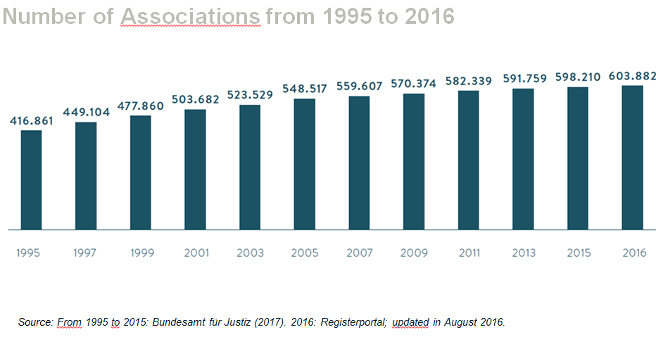
Civil Society in Germany
CIVIL SOCIETY IS GROWING

Slide 8
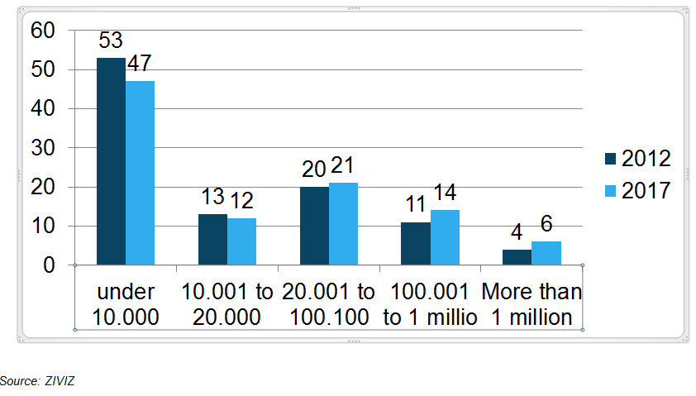
Civil Society in Germany
ANNUAL BUDGETS OF CSO`S

Slide 9
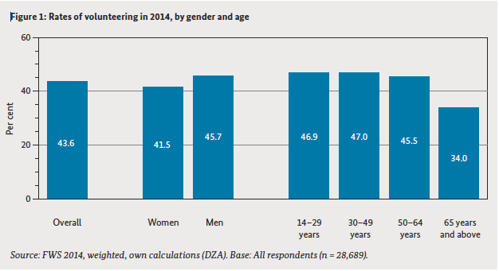
Civil Society in Germany
Volunteering among various population groups
population groups

Slide 10
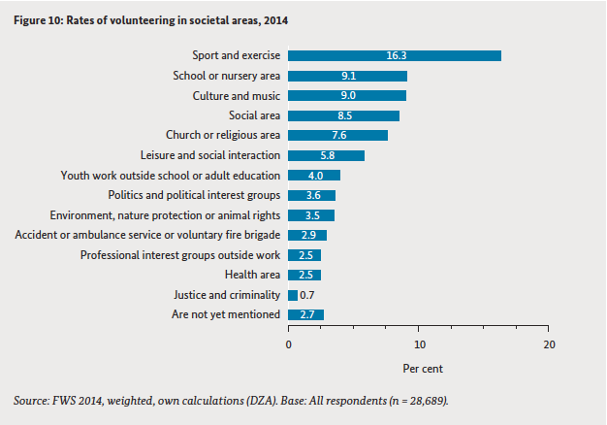
Civil Society in Germany
Societal areas in which voluntary work is done

Slide 11
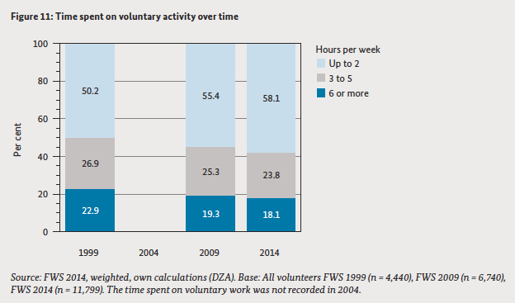
Civil Society in Germany
Time spent on voluntary activities

Slide 12
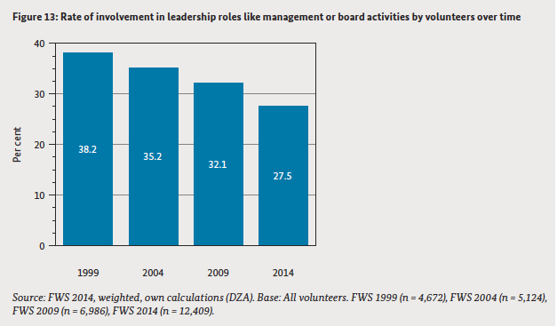
Civil Society in Germany
Leadership roles in voluntary activities

Slide 13
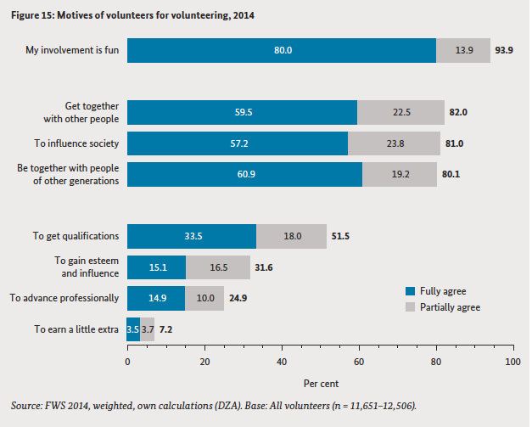
Civil Society in Germany
Motives for volunteering

Slide 14
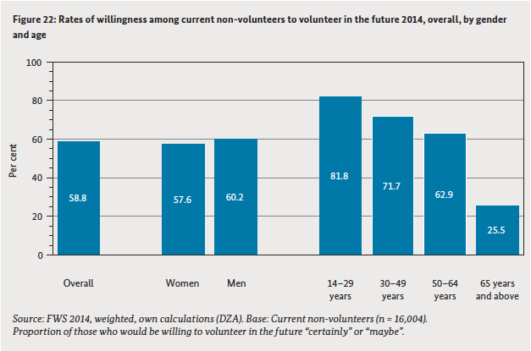
Civil Society in Germany
Willingness to volunteer by current non-volunteers

Slide 15
Civil Society in Germany
Thank you for your attention
National Network for Civil Society (BBE)
Michaelkirchstraße 17/18
10179 Berlin
Tel. +49 30 62980 – 110
frank.heuberger@gmail.com
www.b-b-e.de

